Slide 1
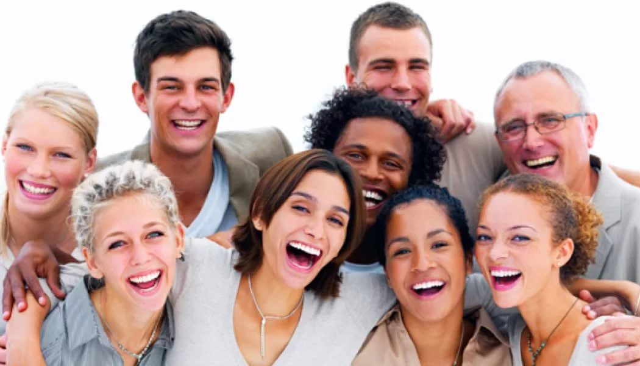
People

Slide 2
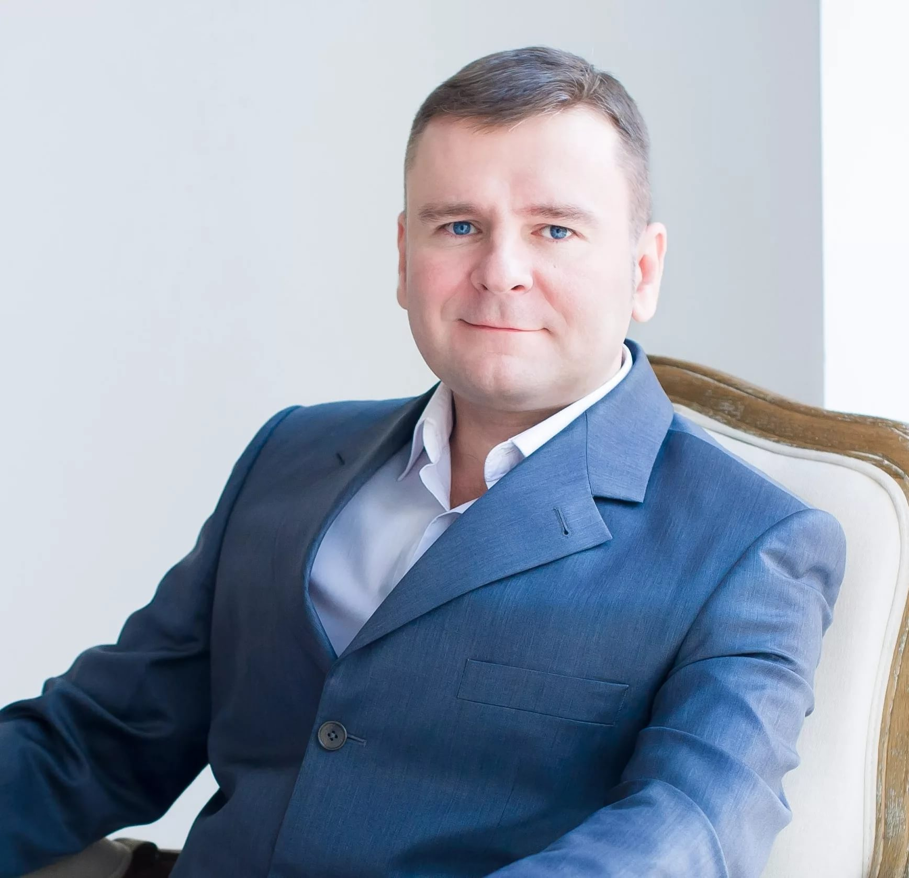
Middle – aged man

Slide 3
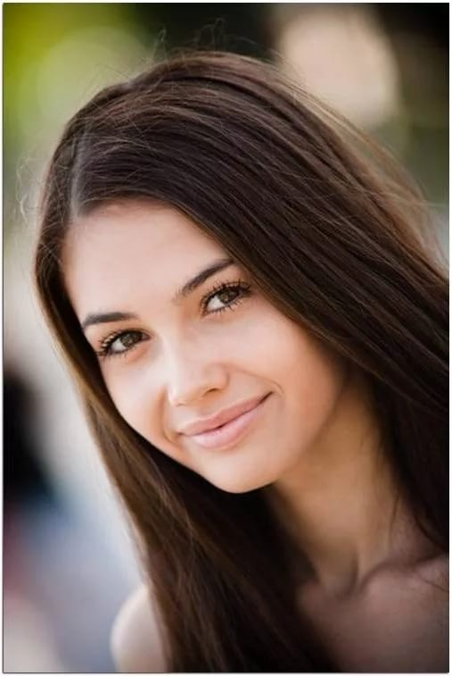
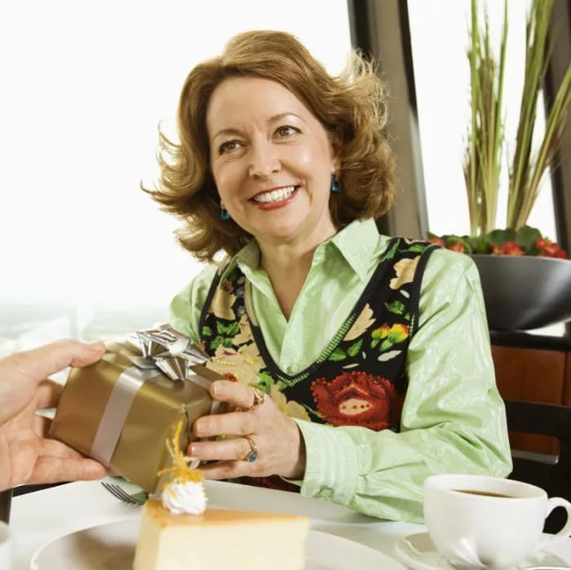
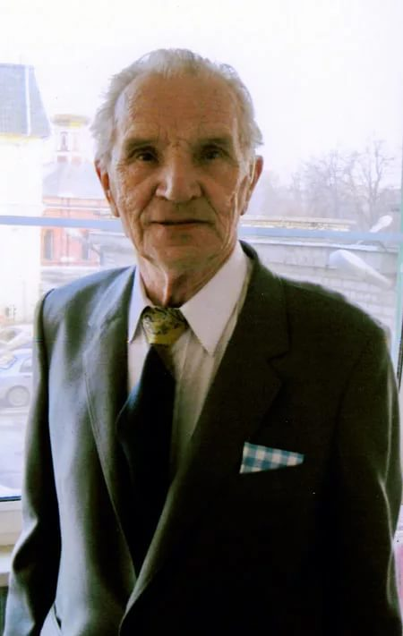
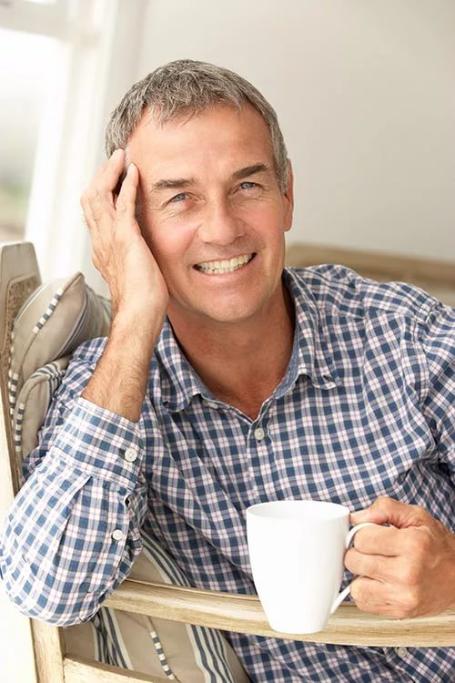
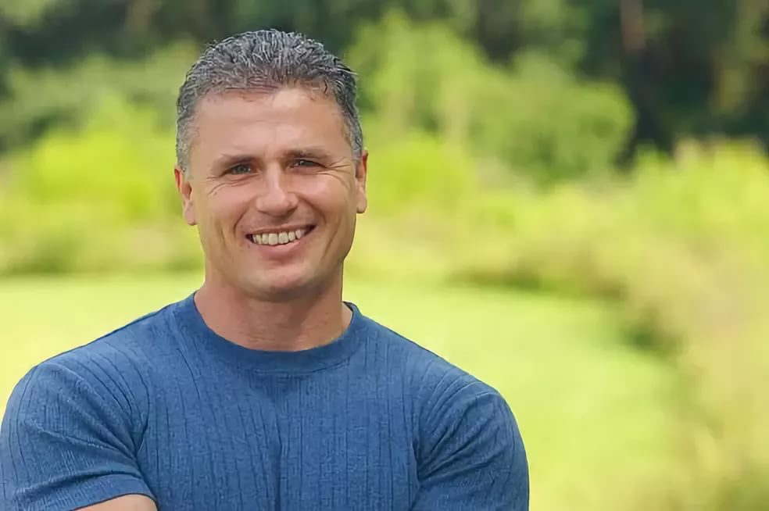
Age
60s
20s
80s
40s
40s

Slide 4
Adjectives
Optimistic
Shy
Selfish
Reliable
Stubborn
Sincere
Sensitive
Sociable
Patient
Easy going

Slide 5
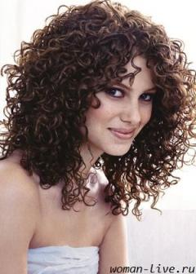
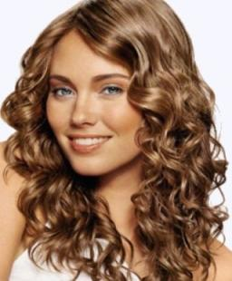
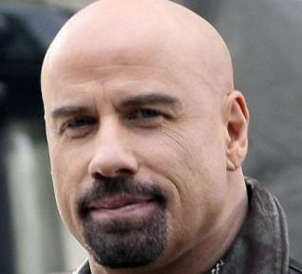
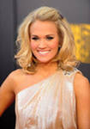
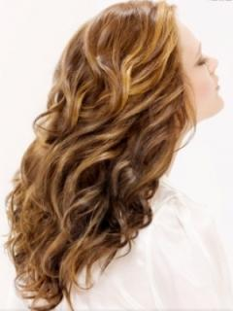
Hair
frizzy
bald
curly
wavy
Beard and moustache
Shoulder-length

Slide 6
Match the adjectives to their opposites
1.shy
2. selfish
3. reliable
4. stubborn
5. sincere
6. sensitive
7. sociable
8. patient
9. easy going
10. optimistic
a. confident
b. generous
c. pessimistic
d. flexible
e. unreliable
f. unsociable
g. irritable
h. inpatient
i. insincere
j. insensitive

Slide 7
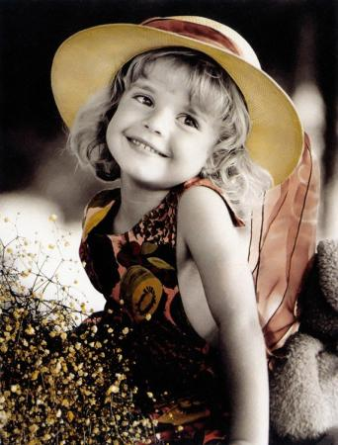
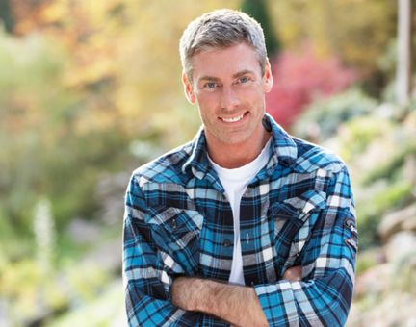
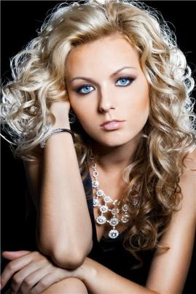
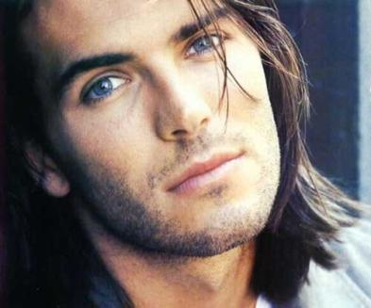
Looks
pretty
Good-looking
beautiful
handsome

Slide 8
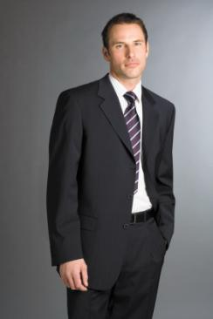
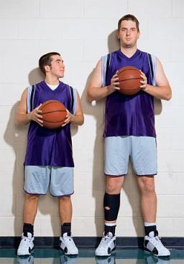
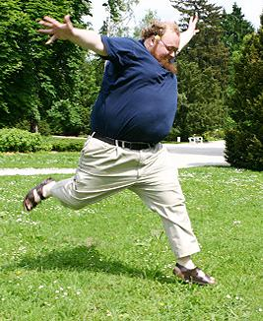
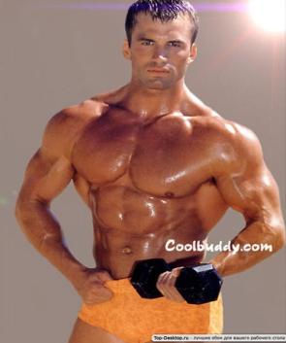
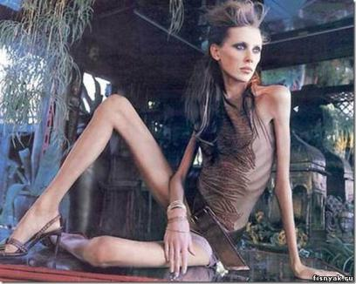
Height and Weight
Of medium build
overweight
muscular
skinny

